Slide 1
Green Transition in Public Procurement (What is the status quo in Poland?)
Michał Kania
University of Silesia in Katowice
Public Procurement Law Association

Slide 2
Polish Public procurement market in 2019
Number of agreements: 141 023
Value: 25 693 896,94 Euro
Contracting authorities: 32 000
Green Public procurement in 2019
Number of ”Green’’ agreements: 1 511
Number of ”Green” public procurement: 1%
Value of ”Green” procurements: 3%
”Green’’ contracting authorities: 333

Slide 3
Green Public Procurement in Poland
Art. 29 (4) PPA → Art. 70 Directive 2014/24/EU
Environmental contract performance conditions
Number: 791
Value: 1 071 415 149,81
Article 30 (a) PPA → Art. 43 Directive 2014/24/EU
Eco-labels
Number: 195
Value: 212 536 392,76

Slide 4
Green Public Procurement in Poland
Art. 91 (2) (3)→ Article 67 (2) Directive 2014/24/EU
The MEAT criteria with the reference to environmental aspects
Number: 97
Value: 189 698 393,42
Art. 91 (3) (b) PPA → Art. 68 Directive 2014/24/EU
The life cycle cost approach
Number: 23
Value: 25 693 896,94

Slide 5
Green Public Procurement in Poland
1% of all public procurement agreements
3% of the total market value
1% of the ’’green’’ contracting authorities
Leader in the ranking of the most polluted cities in the EU

Slide 6
Towards Green Public Procurement in Poland Possible ways?
Act of 20 May 2016 on energy efficiency
Act of 29 August 2014 on the energy performance of buildings
Act of 14 September 2012 on the obligations to provide information on the consumption of energy consumption of energy-using products
The regulation of the Prime Minister of 10 May 2011 on other than mandatory tender evaluation criteria for certain types of public procurement public procurement
And more…
The development of skills, competency and organisational culture towards GPP in Poland
Guidlines issued by the Polish PPO
PPO cooperation with other gov. agencies and bodies
”Buying Green” Handbook
Other EC tools for the support of GPP

Slide 7
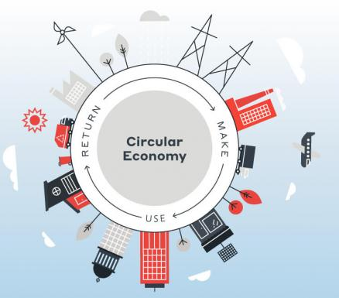

Slide 8
Polish challenges in the implementation of Green public procurement
The Polish public procurement market ecosystem
Knowledge about GPP, attributes and benefits
Skills and competence challenges
Poor cooperation with the private market
Low capacities on the supply side

Slide 9
Selected legal instruments supporting ”Green’’ aspects in the new Polish PPL (except existing solutions)
Article 17 (1) (2): New efficiency rule
Article 21 (1): State purchaseing policy
Article 83 (3) (4): Analysis of the public buyer’s needs
Article 129 and 275: the strengthening of the negotiations procedures
Article 446 (3) (4): Report on contract implementation

Slide 10
Thank you!
www.5pcommonplace.com
michal.kania@us.edu.pl

